Slide 1


Azure Dev-Ops / Bitbucket integration

Slide 2
Agenda
Why Azure Dev-ops
Integration bitbucket with Azure dev-ops
CI
CD

Slide 3
Why Azure dev-ops ?

Slide 4
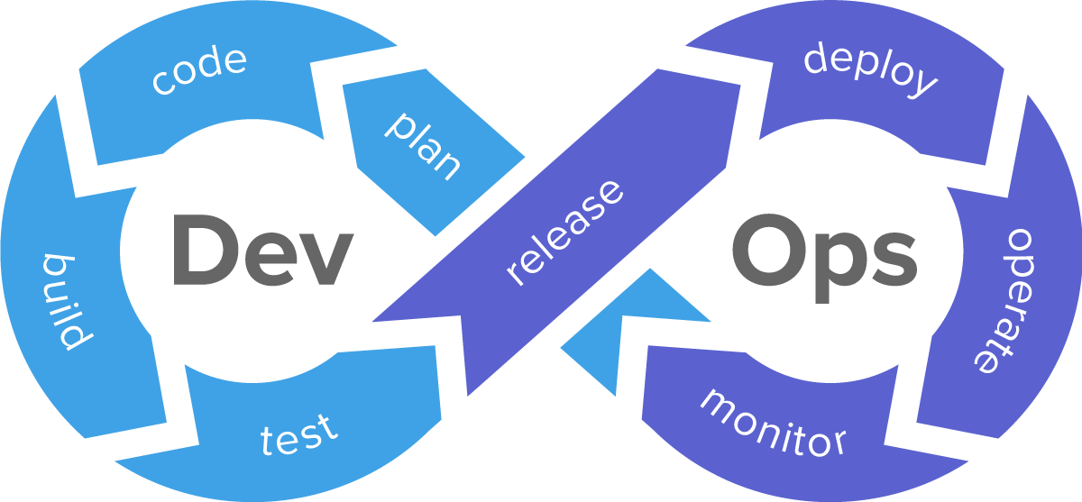

Slide 5
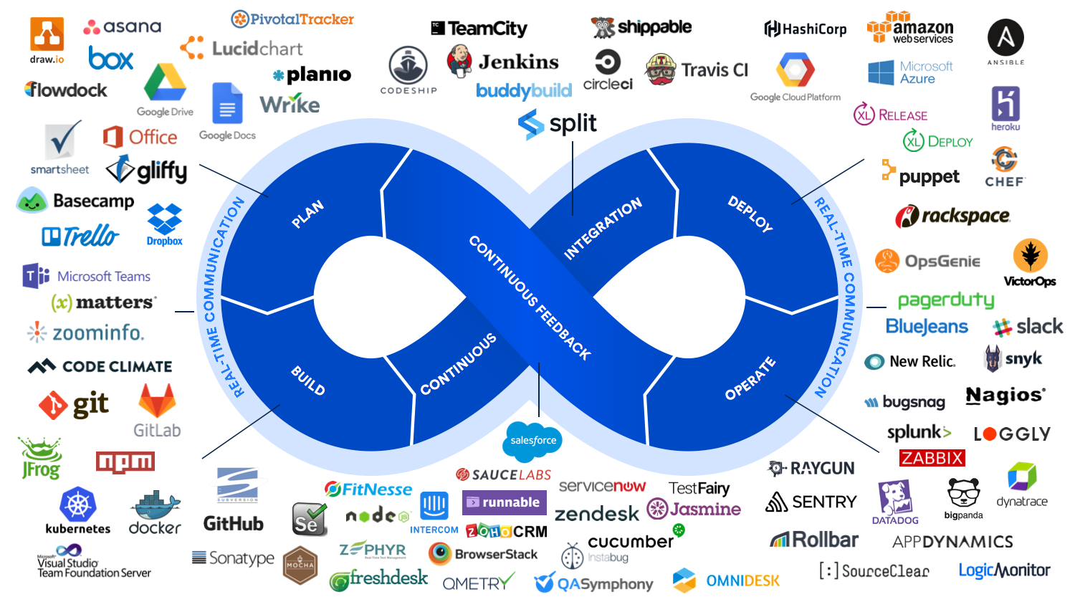

Slide 6


Slide 7
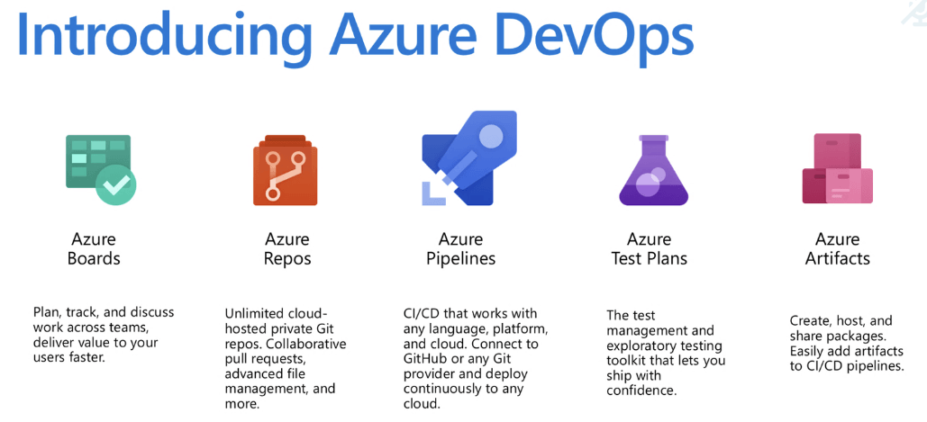

Slide 8
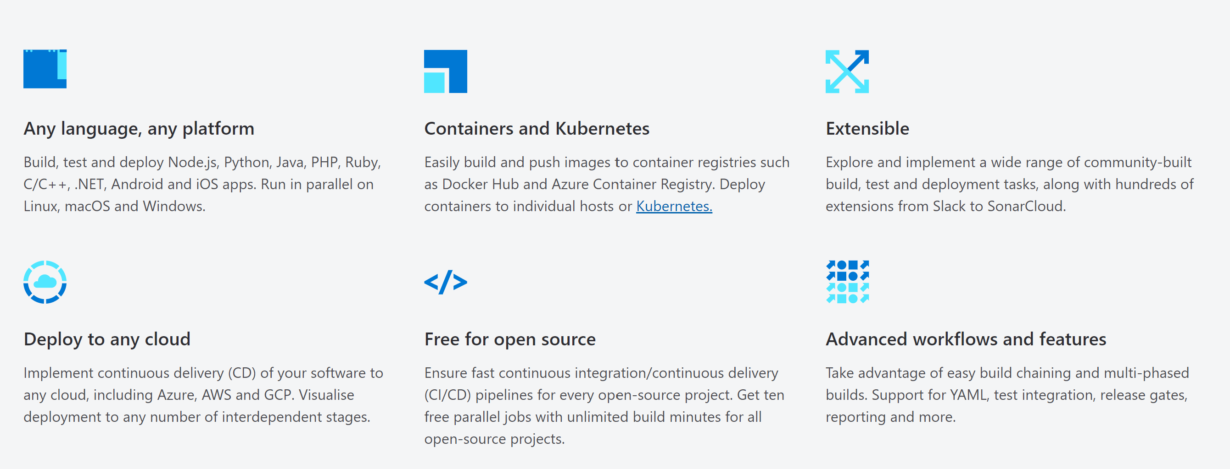

Slide 9

Demo

Slide 10
Step 1
Install dot net Core web api locally

Slide 11
Step 2
Push code from local to bitbucket

Slide 12
Step 3
Integrate bitbucket to Azure Dev-ops
And
Set Up CI

Slide 13
Step 4
Set-up cd and release to azure app service

Slide 14
Summary
Why Azure dev-ops
Product and features of Azure dev-ops
Push code from local to Repo using GIT
Bitbucket and Azure dev-ops integration
Continues Integration
Azure App service
Continue Deployment

Slide 15
Resources
Git: https://git-scm.com/
Azure-Devops:https://docs.microsoft.com/en-us/azure/devops/?view=azure-devops
Demo: https://github.com/picoage/Demo-Azuredevops-Bitbucket

